Slide 1
Hiwi Meeting 6
Date: 06/06/2020

Slide 2
Workflow
Hyperparameter script : holds all common tunable hyperparameters
Feature Selection : holds all the methods of Feature Selection; Outputs are csv files with selected Features and Label
Models : Contains all classifier models and options to select Feature Selection Method for data
Main : Automates all scripts and lets user select which Model user wants to work with.
here package used as required and all scripts under common Project folder.

Slide 3
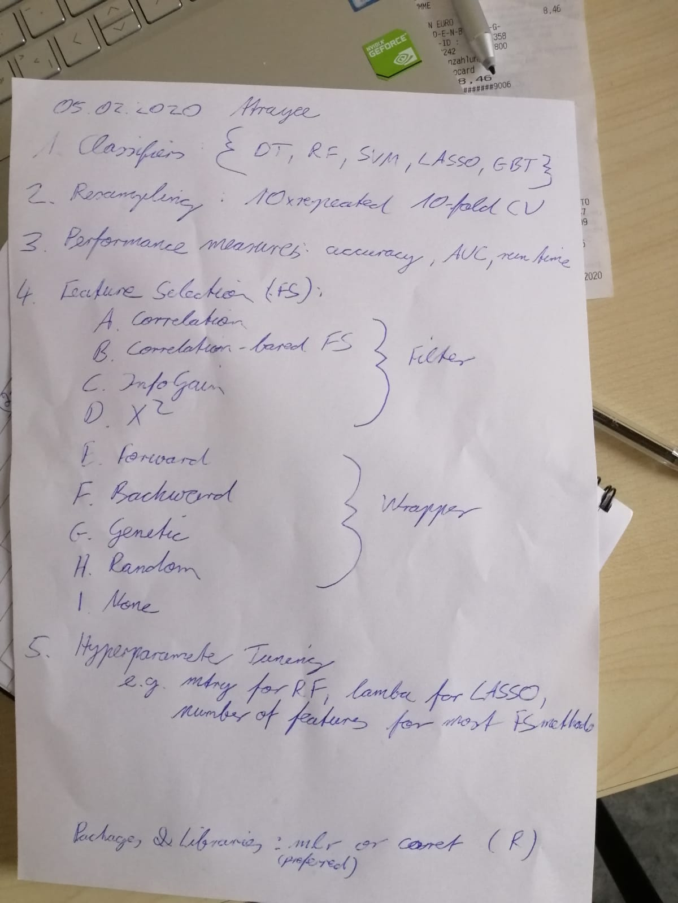
Tasks:

Slide 4
Total Counts:
95 Features after Correlation and removal of Near Zero variance
Type | Healthy | BAV | Total
Healthy v/s BAV | 90 | 22 | 112
Young v/s Old | Young: 53 Old: 37 | Young: 15 Old: 7 | Young: 68 Old: 44
Male v/s Female | Male: 45 Female: 45 | Male : 17 Female: 5 | Male: 62 Female: 50

Slide 5
Classifiers (pathology)
Correlation Based FS:
Model | Number of Features | Accuracy (Testing) | AUC | Kappa | Runtime (sec)
Decision Tree | 19 | 0.818 | 0.694 | 0.388 | 3.04
Random Forest | 19 | 0.939 | 0.833 | 0.765 | 4.68
SVM | 19 | 0.909 | 0.815 | 0.673 | 0.79
GBM | 19 | 0.939 | 0.898 | 0.796 | 2.67
Lasso | 19 | 0.909 | 0.815 | 0.673 | 3.09

Slide 6
Chi-Squared based FS
Model | Number of Features | Accuracy (Testing) | AUC | Kappa | Runtime (sec)
Decision Tree | 31 | 0.909 | 0.814 | 0.673 | 0.33
Random Forest | 94 | 0.969 | 1.000 | 0.891 | 0.23
SVM | 66 | 0.909 | 0.969 | 0.713 | 0.24
GBM | 10 | 0.909 | 0.975 | 0.713 | 0.18
Lasso | 21 | 0.939 | 0.975 | 0.796 | 0.39

Slide 7
Information Gain
Model | Number of Features | Accuracy (Testing) | AUC | Kappa | Runtime (sec)
Decision Tree | 31 | 0.909 | 0.814 | 0.673 | 0.03
Random Forest | 94 | 0.969 | 0.962 | 0.891 | 0.19
SVM | 94 | 0.969 | 1.000 | 0.891 | 0.05
GBM | 84 | 0.969 | 0.962 | 0.891 | 0.02
Lasso | 31 | 0.939 | 0.932 | 0.765 | 0.03

Slide 8
Sequential Algorithm(Forward) based FS:
Model | Number of Features | Accuracy (Testing) | AUC | Kappa | Runtime (sec)
Decision Tree | 2 | 0.878 | 0.935 | 0.639 | 32.16
Random Forest | 3 | 0.939 | 0.969 | 0.796 | 74.64
SVM | 3 | 0.969 | 0.956 | 0.891 | 43.92
GBM | 3 | 0.939 | 0.962 | 0.819 | 43.77
Lasso

Slide 9
Sequential Algorithm(Backward) based FS:
Model | Number of Features | Accuracy (Testing) | AUC | Kappa | Runtime (sec)
Decision Tree | 1 | 0.909 | 0.814 | 0.673 | 673.11
Random Forest | 77 | 0.969 | 0.972 | 0.891 | 1016.13
SVM | 91 | 0.969 | 1.000 | 0.891 | 1350.81
GBM | 91 | 0.969 | 0.950 | 0.891 | 192.2
Lasso | 91 | 0.909 | 0.969 | 0.620 | 744.38

Slide 10
Genetic Algorithm based FS:
Model | Number of Features | Accuracy (Testing) | AUC | Kappa | Runtime (sec)
Decision Tree | 48 | 0.909 | 0.814 | 0.673 | 10.1
Random Forest | 53 | 0.909 | 0.981 | 0.673 | 32.57
SVM | 43 | 0.939 | 0.993 | 0.819 | 14.66
GBM | 46 | 0.969 | 0.981 | 0.891 | 17.25
Lasso | 54 | 0.939 | 0.925 | 0.765 | 12.58

Slide 11
Random based FS:
Model | Number of Features | Accuracy (Testing) | AUC | Kappa | Runtime (sec)
Decision Tree | 52 | 0.909 | 0.814 | 0.673 | 2.47
Random Forest | 53 | 0.939 | 0.962 | 0.796 | 4.95
SVM | 43 | 0.969 | 0.987 | 0.891 | 2.68
GBM | 51 | 0.909 | 0.987 | 0.673 | 3.36
Lasso | 96 | 0.909 | 0.919 | 0.673 | 2.28

Slide 12
No FS Methods:
Model | Number of Features | Accuracy (Testing) | AUC | Kappa | Runtime (sec)
Decision Tree | 95 | 0.818 | 0.500 | 0.246 | 3.04
Random Forest | 95 | 0.969 | 0.981 | 0.891 | 0.34
SVM | 95 | 0.969 | 0.981 | 0.891 | 0.07
GBM | 95 | 0.939 | 1.000 | 0.765 | 0.39
Lasso | 95 | 0.909 | 0.750 | 0.620 | 0.03

Slide 13
Results:Optimal Combination
Model | Features | Acc | Kappa | AUC | Time | Kappa.mean | S.D.
SVM | 3 | 0.969 | 0.901 | 0.891 | 43.92 | 0.702 | 0.400
GBM | 3 | 0.939 | 0.962 | 0.819 | 43.77 | 0.735 | 0.386
RF | 3 | 0.939 | 0.969 | 0.796 | 74.64 | 0.720 | 0.412
SVM:
"maxVortexVolume" "diastolicMaxLeftRotationVolumeRel" "systolicMaxMeanPressureInVortexRegion"
RF:
"maxVortexVolumeTime" "maxOverallCircumferentialVelocityTime" "systolicMaxMeancircumferentialVelocity"
GBM:
"maxVortexVolumeTime" "diastolicMaxVortexVolumeTime" "medianMeanPressureInVortexRegion"
Decision Tree:
"maxVortexVolume" "diastolicMaxMeanAxialVelocityTime"

Slide 14
Visualizations

Slide 15
Healthy v/s BAV

Slide 16
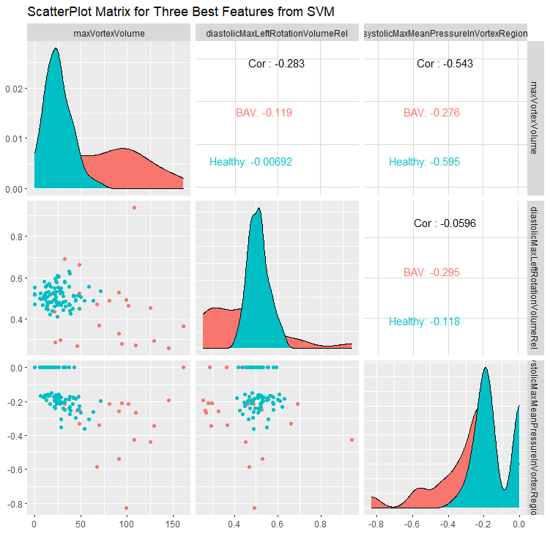
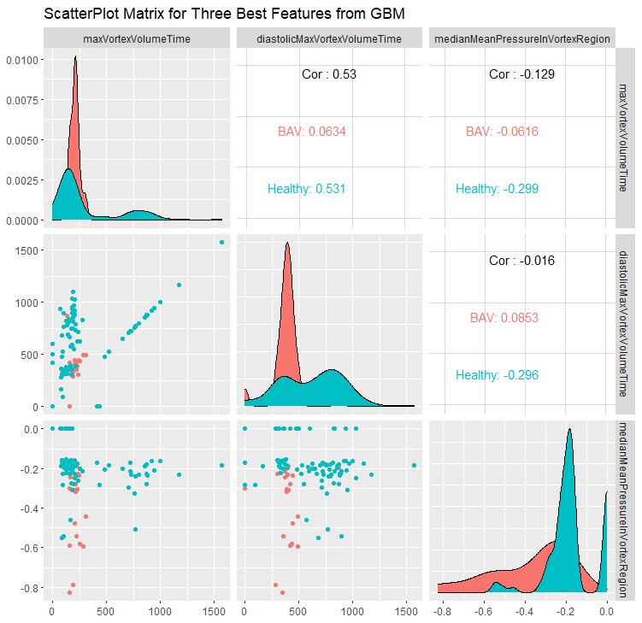
Healthy v/s BAV

Slide 17
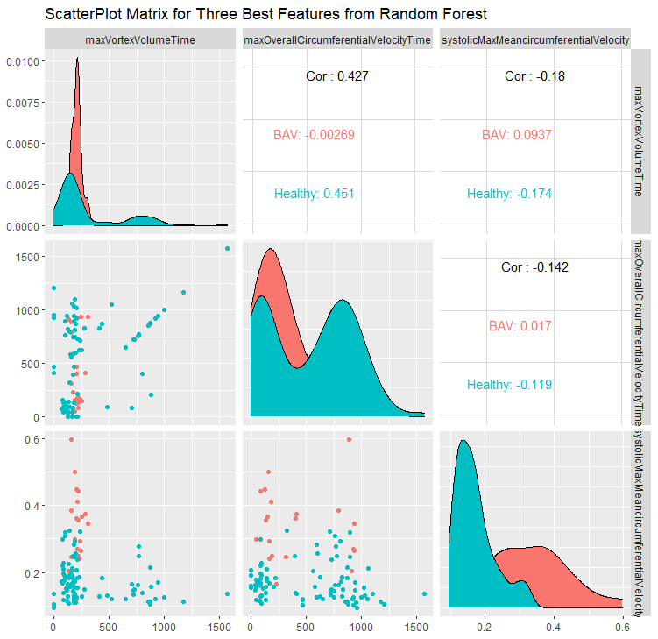
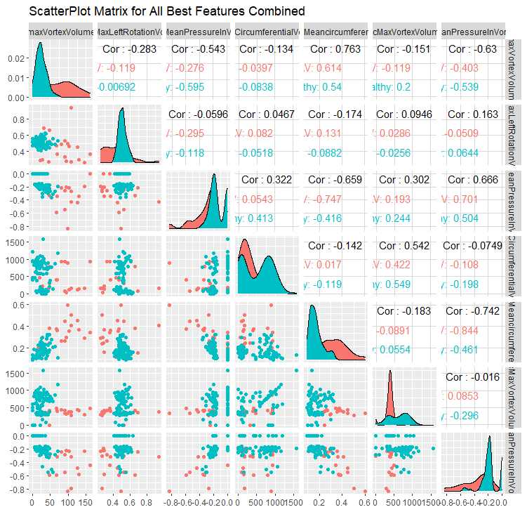
Healthy v/s BAV

Slide 18
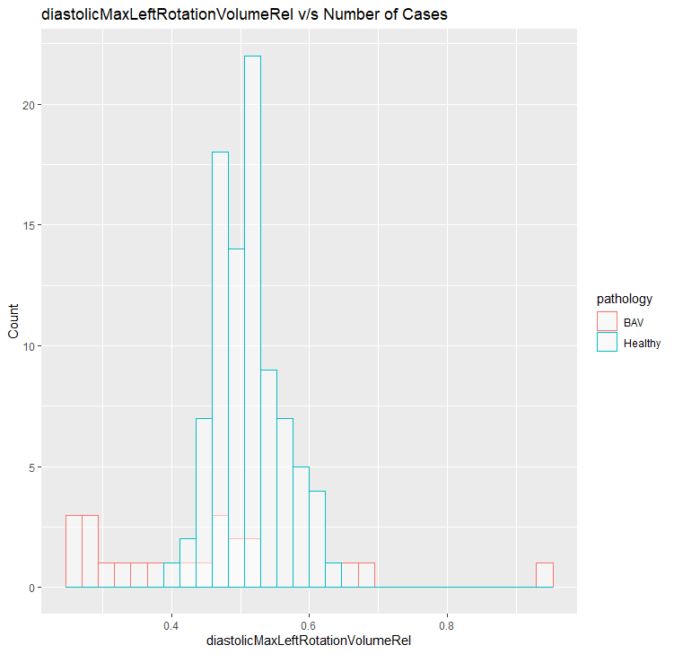
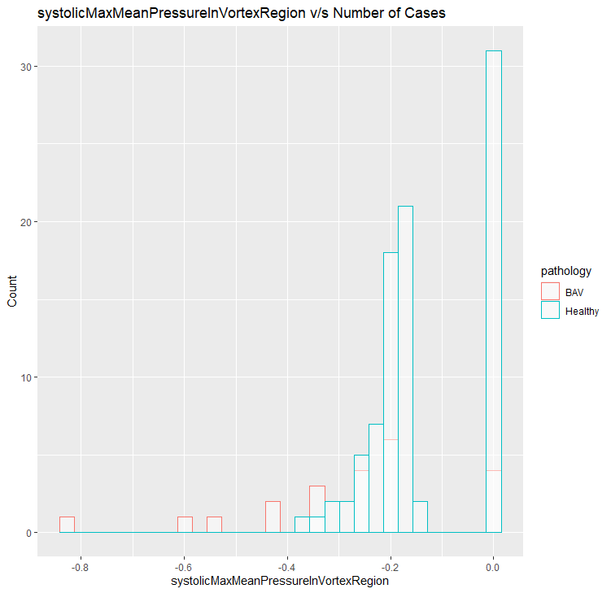
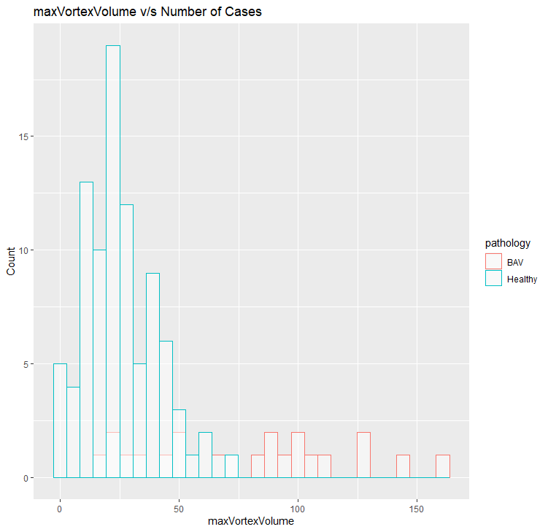
Healthy v/s BAV SVM

Slide 19
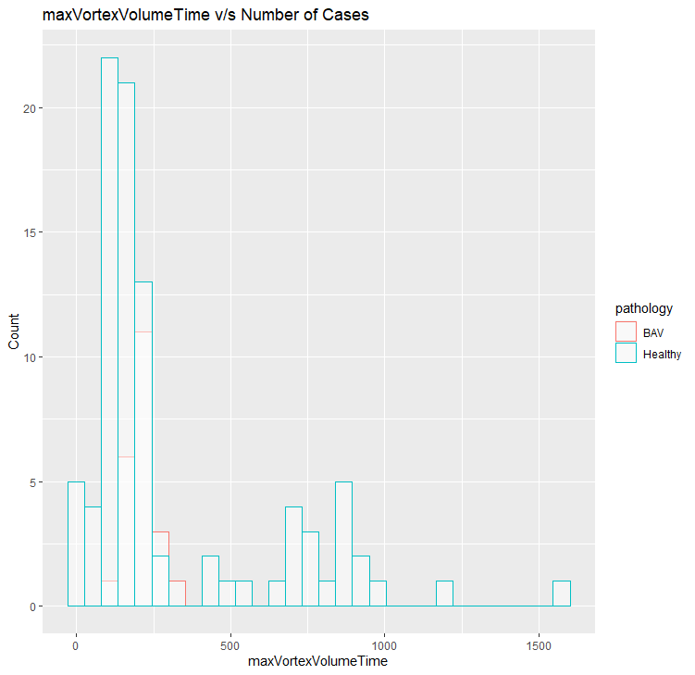
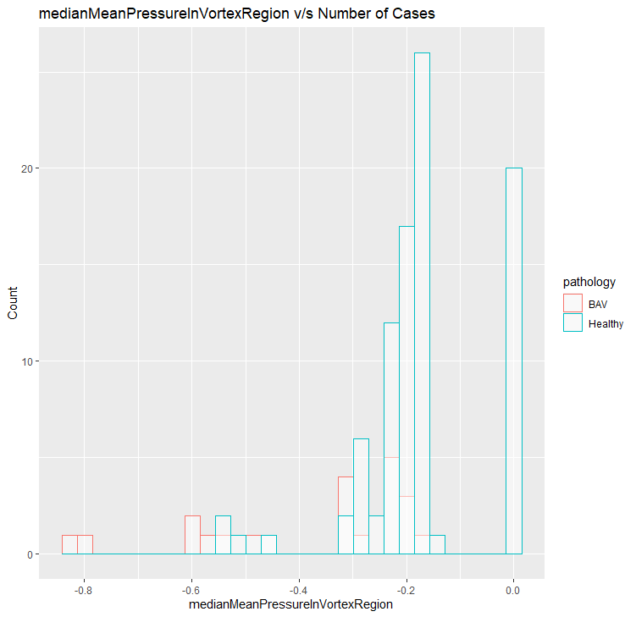
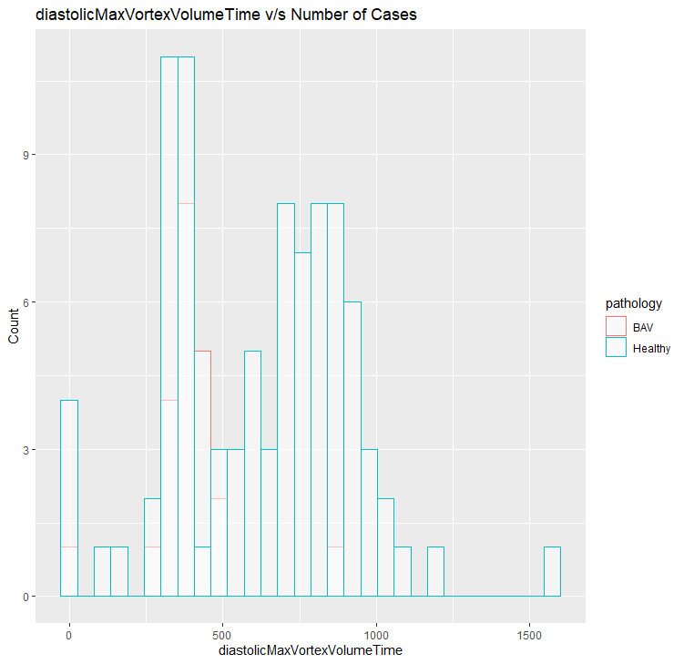
Healthy v/s BAV GBM

Slide 20
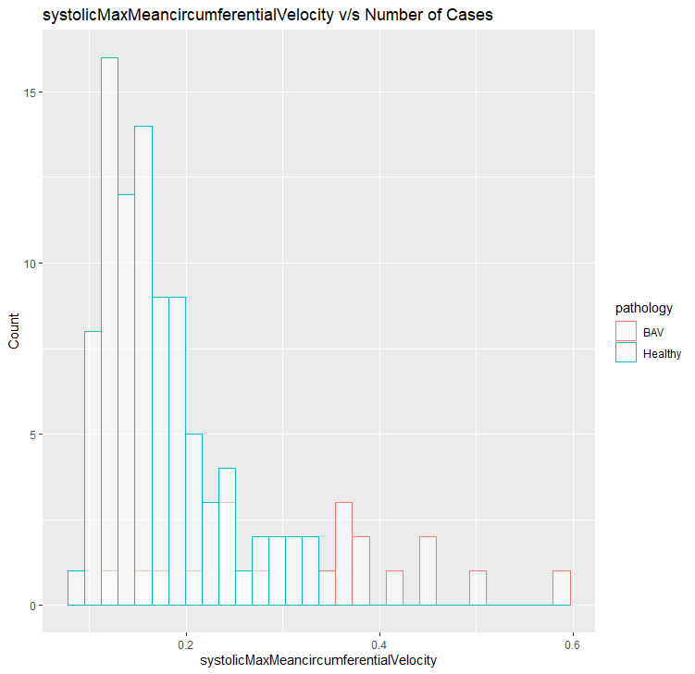
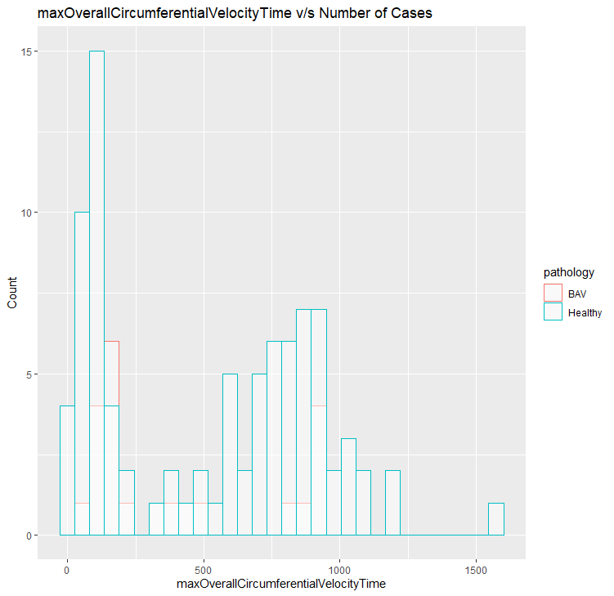
Healthy v/s BAV RF

Slide 21
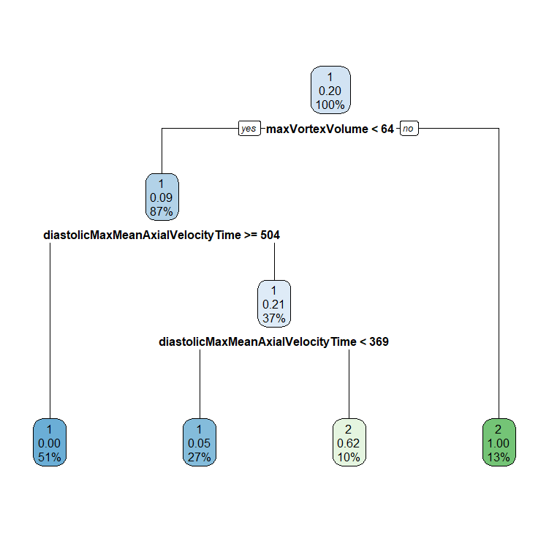
Decision Tree

Slide 22
Conclusions: Healthy v/s BAV
maxVortexVolume is an important feature as it is selected for two different Classifiers as well as it’s versions maxVortexVolumeTime is selected by the other two.
The best results are with the combination SVM and Sequential Forward Feature Selection method

Slide 23
Old Healthy v/s BAV

Slide 24
Classifiers (age)
Correlation Based FS:
Model | Number of Features | Accuracy (Testing) | AUC | Kappa | Runtime (sec)
Decision Tree | 6 | 0.866 | 0.833 | 0.705 | 3.04
Random Forest | 5 | 0.866 | 0.861 | 0.722 | 1.62
SVM | 16 | 0.866 | 0.861 | 0.722 | 0.87
GBM | 12 | 0.730 | 0.801 | 0.461 | 0.50
Lasso | 7 | 0.800 | 0.778 | 0.571 | 1.61

Slide 25
Chi-Squared based FS
Model | Number of Features | Accuracy (Testing) | AUC | Kappa | Runtime (sec)
Decision Tree | 28 | 0.866 | 0.833 | 0.705 | 0.12
Random Forest | 85 | 0.933 | 1.000 | 0.864 | 0.41
SVM | 47 | 0.933 | 0.962 | 0.857 | 0.28
GBM | 47 | 0.933 | 0.990 | 0.864 | 0.16
Lasso | 28 | 0.933 | 0.981 | 0.864 | 0.17

Slide 26
Information Gain
Model | Number of Features | Accuracy (Testing) | AUC | Kappa | Runtime (sec)
Decision Tree | 28 | 0.866 | 0.833 | 0.705 | 0.02
Random Forest | 85 | 0.866 | 1.000 | 0.736 | 0.05
SVM | 47 | 0.933 | 0.962 | 0.857 | 0.05
GBM | 47 | 0.933 | 0.981 | 0.864 | 0.02
Lasso | 28 | 0.933 | 0.981 | 0.864 | 0.03

Slide 27
Sequential Algorithm(Forward) based FS:
Model | Number of Features | Accuracy (Testing) | AUC | Kappa | Runtime (sec)
Decision Tree | 1 | 0.800 | 0.777 | 0.571 | 14.92
Random Forest | 3 | 0.866 | 0.925 | 0.722 | 54.41
SVM | 5 | 1.000 | 1.000 | 1.000 | 23.86
GBM | 1 | 0.800 | 0.777 | 0.571 | 23.68
Lasso

Slide 28
Sequential Algorithm(Backward) based FS:
Model | Number of Features | Accuracy (Testing) | AUC | Kappa | Runtime (sec)
Decision Tree | 1 | 0.866 | 0.833 | 0.705 | 549.7
Random Forest | 32 | 0.933 | 1.000 | 0.933 | 1140.24
SVM | 8 | 0.866 | 0.814 | 0.722 | 927.56
GBM | 2 | 0.933 | 0.990 | 0.864 | 457.64
Lasso | 79 | 1.000 | 1.000 | 1.000 | 425.6

Slide 29
Genetic Algorithm based FS:
Model | Number of Features | Accuracy (Testing) | AUC | Kappa | Runtime (sec)
Decision Tree | 46 | 0.866 | 0.861 | 0.722 | 9.59
Random Forest | 36 | 0.866 | 1.000 | 0.736 | 0.05
SVM | 48 | 0.933 | 0.981 | 0.864 | 0.01
GBM | 37 | 0.733 | 0.946 | 0.500 | 0.04
Lasso | 40 | 0.866 | 0.796 | 0.722 | 10.58

Slide 30
Random based FS:
Model | Number of Features | Accuracy (Testing) | AUC | Kappa | Runtime (sec)
Decision Tree | 37 | 0.866 | 0.861 | 0.722 | 1.54
Random Forest | 50 | 0.933 | 1.000 | 0.864 | 0.01
SVM | 38 | 0.933 | 0.981 | 0.864 | 0.04
GBM | 46 | 0.902 | 0.864 | 0.731 | 0.04
Lasso | 41 | 0.933 | 0.944 | 0.857 | 1.62

Slide 31
No FS Methods:
Model | Number of Features | Accuracy (Testing) | AUC | Kappa | Runtime (sec)
Decision Tree | 85 | 0.800 | 0.777 | 0.571 | 3.04
Random Forest | 85 | 0.866 | 0.768 | 0.705 | 0.34
SVM | 85 | 0.733 | 0.925 | 0.444 | 0.07
GBM | 85 | 0.866 | 0.768 | 0.705 | 0.04
Lasso | 85 | 0.933 | 0.917 | 0.857 | 0.03

Slide 32
Results:Optimal Combination
Model | Features | Acc | Kappa | AUC | Time | Kappa.mean | S.D.
RF | 3 | 0.866 | 0.925 | 0.722 | 54.41 | 0.904 | 0.201
DT | 1 | 0.800 | 0.777 | 0.571 | 14.92 | 0.754 | 0.350
GBM | 1 | 0.800 | 0.777 | 0.571 | 23.68 | 0.694 | 0.354
RF:
"maxVortexVolumeTime" "systolicMaxVortexVolume" "diastolicMedianRightRotationVolumeRel"
GBM:
"diastolicMedianRightRotationVolumeRel"
Decision Tree:
"diastolicMedianRightRotationVolumeRel"

Slide 33
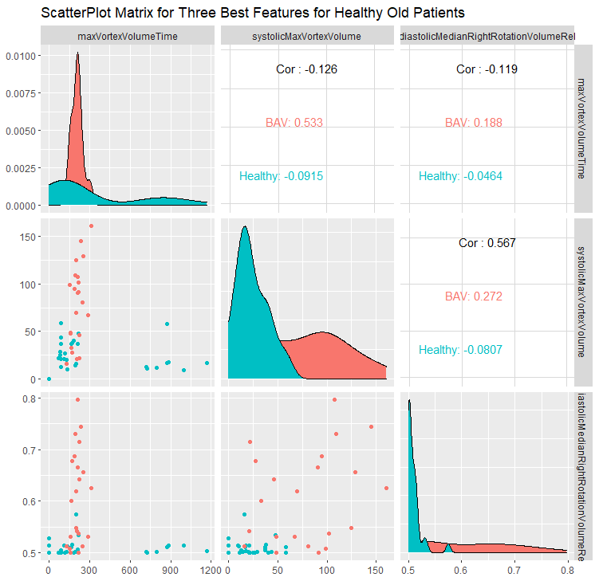
Healthy v/s BAV

Slide 34
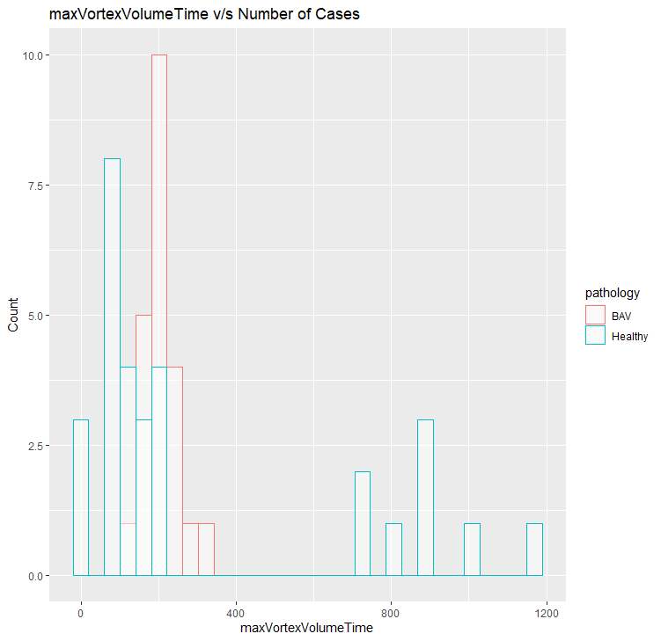
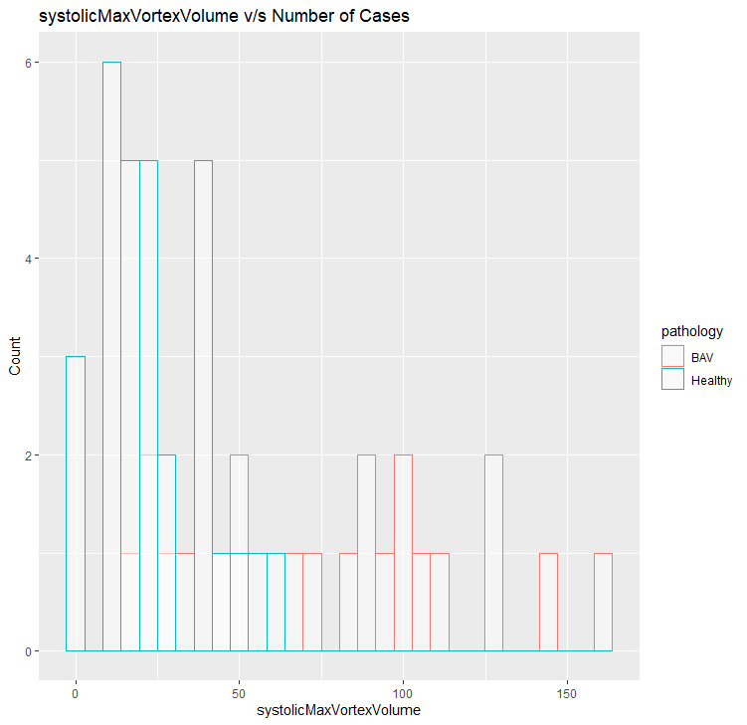
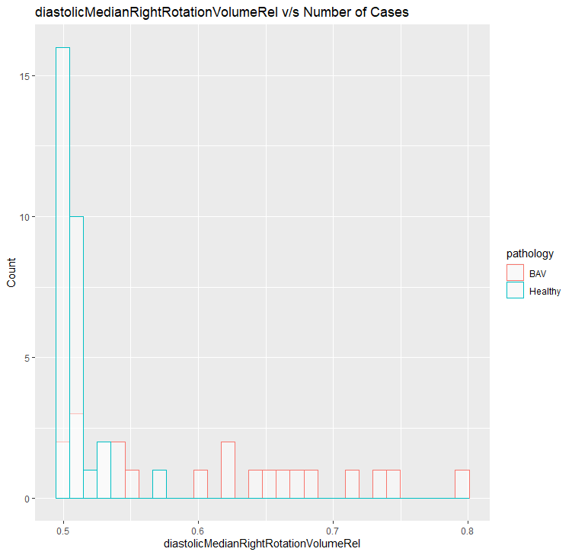
Healthy v/s BAV RF

Slide 35
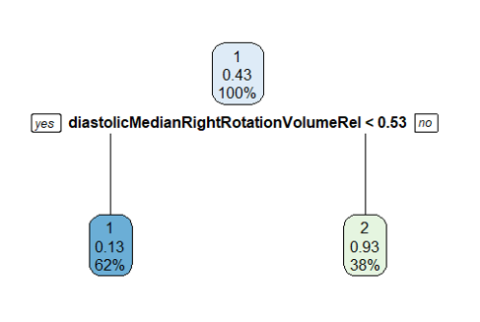
Decision Tree

Slide 36
Conclusions: Old Healthy Patients:
All misclassifications were Pathological patients being classified as Healthy.
Age ranges were from 23-74
Removing the Age feature also did not result in the misclassifications being too high.
According to the results, old Healthy patients do not have the same flow conditions as the Young Pathological ones, as Accuracy is pretty high.

Slide 37
Healthy Male v/s Healthy Female

Slide 38
Classifiers (gender)
Correlation Based FS:
Model | Number of Features | Accuracy (Testing) | AUC | Kappa | Runtime (sec)
Decision Tree | 3 | 0.500 | 0.500 | 0.000 | 3.04
Random Forest | 5 | 0.423 | 0.423 | -0.153 | 0.05
SVM | 10 | 0.423 | 0.423 | -0.153 | 0.01
GBM | 3 | 0.538 | 0.538 | 0.076 | 0.17
Lasso | 3 | 0.269 | 0.269 | -0.461 | 0.03
meanMeanAxialVelocity
diastolicMaxOverallVelocityQ99Time
minFlowJetHighVelocityAreaPercentVelocityWeighted

Slide 39
Chi-Squared based FS
Model | Number of Features | Accuracy (Testing) | AUC | Kappa | Runtime (sec)
Decision Tree | 35 | 0.846 | 0.846 | 0.692 | 0.25
Random Forest | 35 | 0.807 | 0.878 | 0.615 | 0.19
SVM | 12 | 0.576 | 0.573 | 0.153 | 0.04
GBM | 12 | 0.730 | 0.792 | 0.461 | 0.17
Lasso | 35 | 0.692 | 0.852 | 0.384 | 0.27

Slide 40
Information Gain
Model | Number of Features | Accuracy (Testing) | AUC | Kappa | Runtime (sec)
Decision Tree | 35 | 0.846 | 0.846 | 0.692 | 0.30
Random Forest | 35 | 0.807 | 0.878 | 0.615 | 0.05
SVM | 12 | 0.576 | 0.573 | 0.153 | 0.02
GBM | 82 | 0.423 | 0.325 | -0.153 | 0.02
Lasso | 35 | 0.692 | 0.852 | 0.384 | 0.03

Slide 41
Sequential Algorithm(Forward) based FS:
Model | Number of Features | Accuracy (Testing) | AUC | Kappa | Runtime (sec)
Decision Tree | 1 | 0.615 | 0.615 | 0.230 | 23.05
Random Forest | 3 | 0.653 | 0.615 | 0.307 | 85.42
SVM | 5 | 0.538 | 0.491 | 0.076 | 34.65
GBM | 4 | 0.538 | 0.535 | 0.076 | 35.54
Lasso

Slide 42
Sequential Algorithm(Backward) based FS:
Model | Number of Features | Accuracy (Testing) | AUC | Kappa | Runtime (sec)
Decision Tree | 1 | 0.769 | 0.840 | 0.538 | 1063.19
Random Forest | 105 | 0.653 | 0.786 | 0.307 | 188.86
SVM | 97 | 0.538 | 0.508 | -0.076 | 185.8
GBM | 102 | 0.346 | 0.331 | -0.307 | 1084.53
Lasso | 85 | 0.730 | 0.816 | 0.461 | 0.01

Slide 43
Genetic Algorithm based FS:
Model | Number of Features | Accuracy (Testing) | AUC | Kappa | Runtime (sec)
Decision Tree | 54 | 0.769 | 0.840 | 0.538 | 8.25
Random Forest | 51 | 0.769 | 0.816 | 0.538 | 33.42
SVM | 54 | 0.423 | 0.420 | -0.153 | 8.71
GBM | 42 | 0.423 | 0.455 | -0.153 | 7.95
Lasso | 61 | 0.846 | 0.869 | 0.692 | 14.14

Slide 44
Random based FS:
Model | Number of Features | Accuracy (Testing) | AUC | Kappa | Runtime (sec)
Decision Tree | 48 | 0.769 | 0.840 | 0.538 | 1.68
Random Forest | 48 | 0.692 | 0.857 | 0.384 | 5.53
SVM | 53 | 0.538 | 0.591 | 0.076 | 1.53
GBM | 57 | 0.461 | 0.378 | -0.076 | 1.28
Lasso | 54 | 0.769 | 0.798 | 0.538 | 3.45

Slide 45
No FS Methods:
Model | Number of Features | Accuracy (Testing) | AUC | Kappa | Runtime (sec)
Decision Tree | 106 | 0.500 | 0.500 | 0.000 | 3.04
Random Forest | 106 | 0.384 | 0.426 | -0.230 | 0.34
SVM | 106 | 0.384 | 0.355 | -0.230 | 0.07
GBM | 106 | 0.500 | 0.562 | 0.000 | 0.04
Lasso | 106 | 0.615 | 0.615 | 0.230 | 0.03

Slide 46
Results:Optimal Combination
Model | Features | Acc | Kappa | AUC | Time | Kappa.mean | S.D.
RF | 3 | 0.653 | 0.615 | 0.307 | 85.42 | 0.211 | 0.170
DT | 1 | 0.615 | 0.615 | 0.230 | 23.05 | 0.324 | 0.365
GBM | 4 | 0.538 | 0.535 | 0.076 | 35.54 | 0.502 | 0.358
RF:
"medianDiameter" "diastolicMinMeanPressureTime" "diastolicMeanMeanPressure"
Decision Tree:
"medianDiameter"
GBM:
"systolicMaxVortexVolumeRel" "maxOverallVelocity" "diastolicMaxLeftRotationVolumeTime"
"maxFlowJetAngleVelocityWeighted"

Slide 47
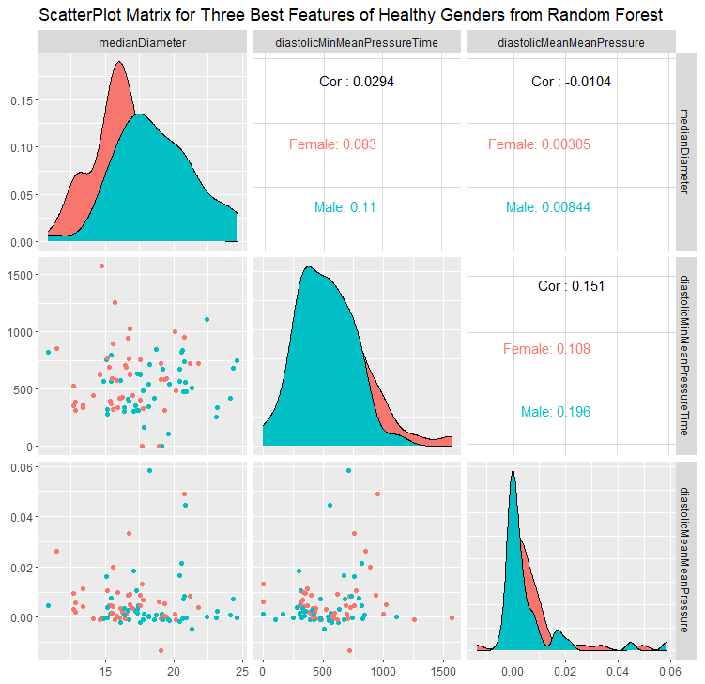
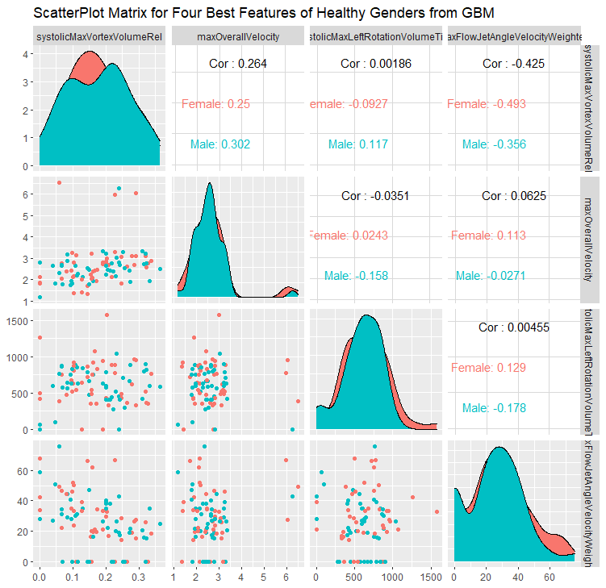
Healthy v/s BAV

Slide 48
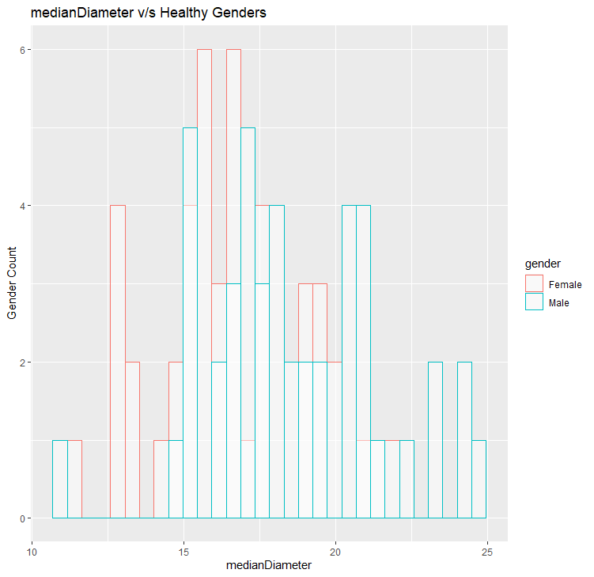
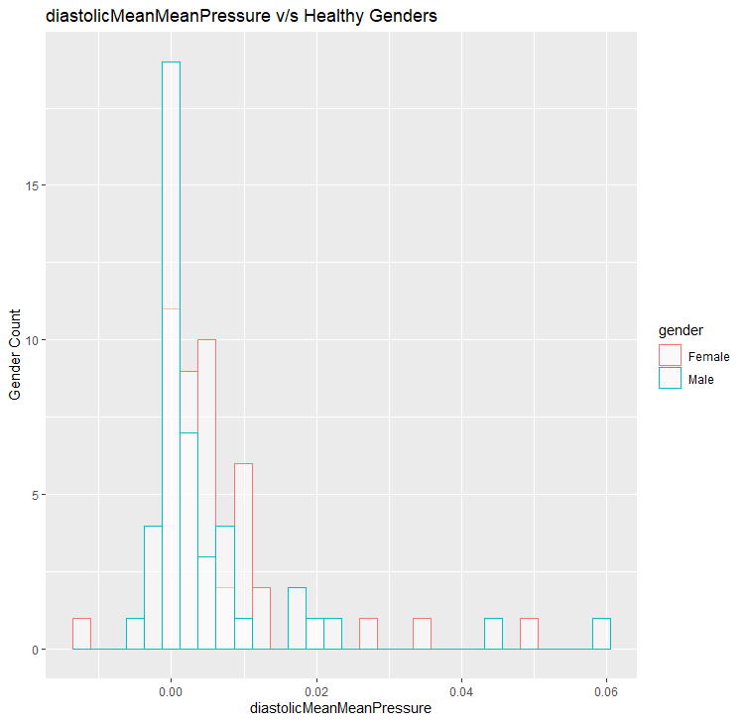
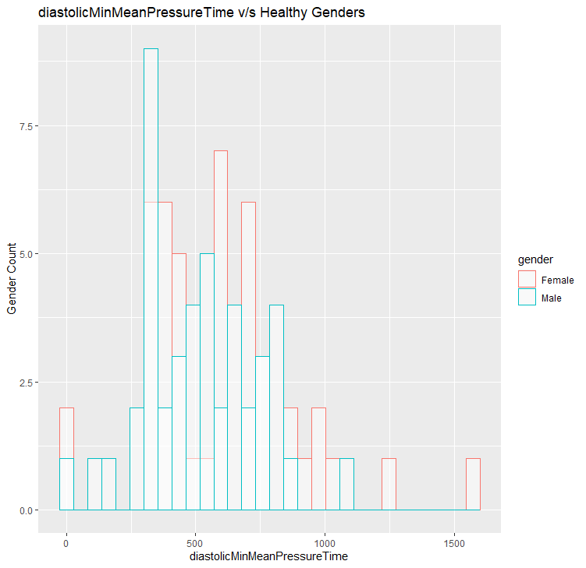
Healthy v/s BAV RF

Slide 49
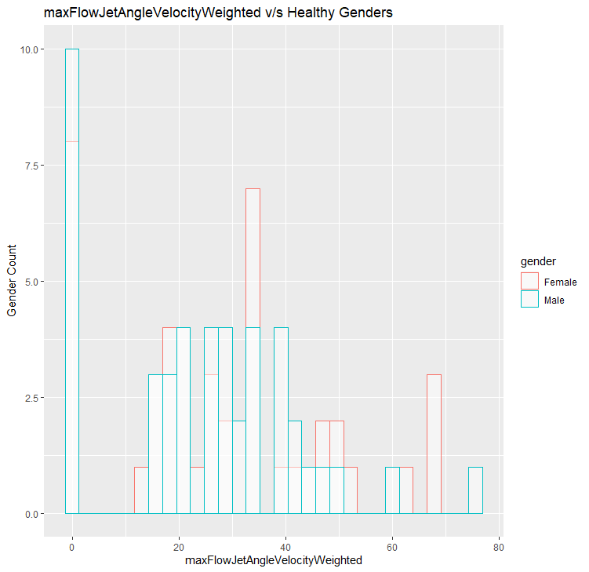
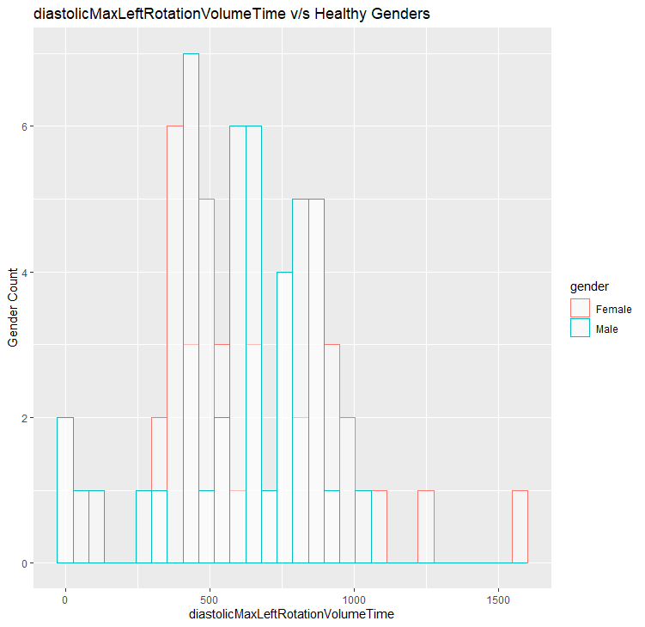
Healthy v/s BAV GBM

Slide 50
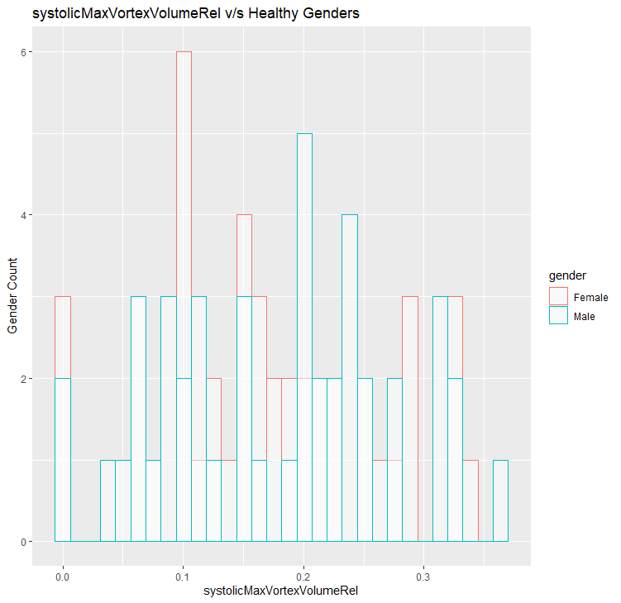
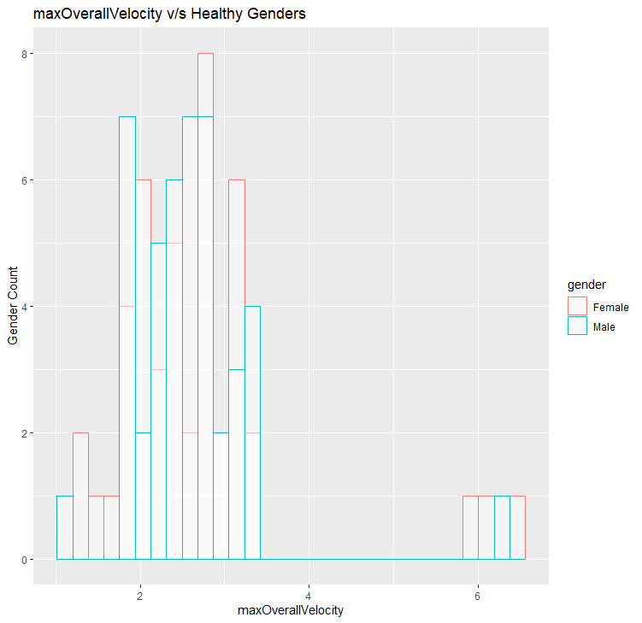
Healthy v/s BAV GBM

Slide 51
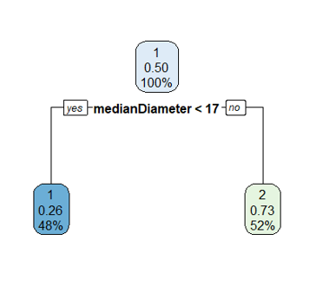
Decision Tree

Slide 52
Conclusions: Male v/s Female
The Accuracy of models is pretty low with low kappa values
The plots were for Features extracted from the following Classifier models for Sequential Forward FS methods:
Random Forest
GBM
DT
The plots also confirm the Hypothesis that the dependence of a patient being Healthy or Pathological is very low.

